Slide 1




Health care analysis

Slide 2

Team Members ( Group - 5 ) :
Mrs. Sonali Shukla
Mrs. Prajakta Rohit Zirkande
Madineni Praveen Kumar
Pasham Vaishnavi
Sivapriya R
Yaswanth Kumar Rajala
Lakkekula Penchala Vardhan

Slide 3

INTRODUCTION :
Overview of Healthcare Analytics :
Healthcare analytics involves analyzing hospital and patient data to improve healthcare services and decision-making.
Global impact:
It helps improve patient care, reduce costs, and increase hospital efficiency through data-driven insights.
Purpose of the Project:
This project aims to analyze key healthcare KPIs to improve hospital performance and support better management decisions.

Slide 4
Goals and Objectives:
Enhance patient care quality and treatment outcomes.
Improve hospital operational efficiency and reduce waiting time.
Integrate accurate and transparent data management systems.
Optimize resource utilization (beds, staff, equipment).
Reduce hospital readmission rates and medical errors.
Ensure patient data security and privacy compliance.
Increase patient satisfaction and service experience.
Support data-driven decision-making for sustainable healthcare growth.

Slide 5
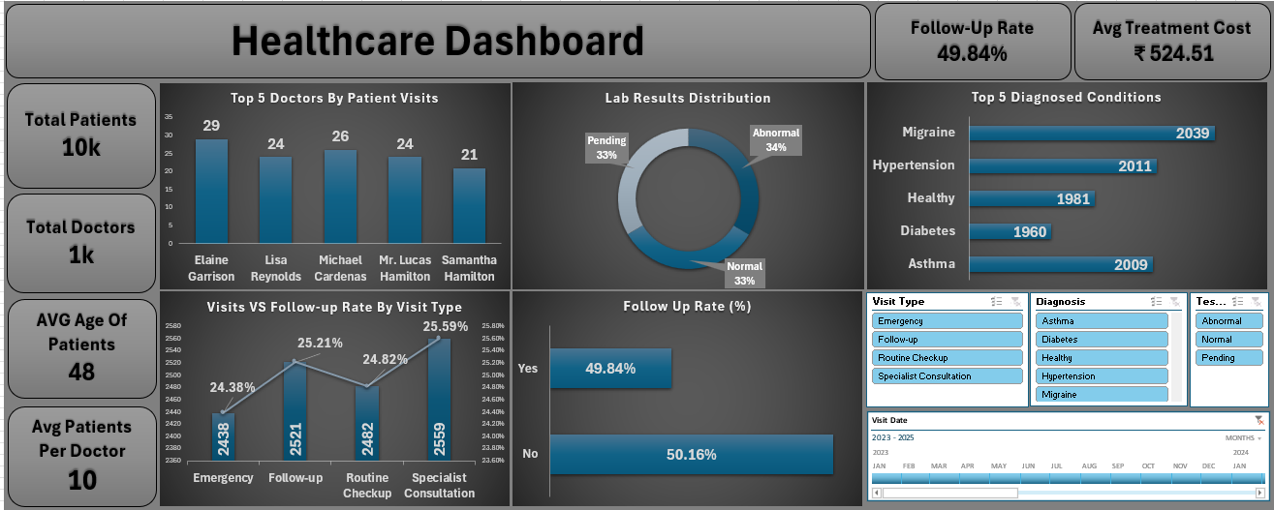
Visual Analysis
Total Doctors
Represents the total number of doctors available in the hospital network.
Shows the hospital’s workforce capacity.
Helps measure doctor availability for patient care.
Indicates operational strength of the healthcare system.
Supports decisions on hiring new doctors.
Ensures balanced workload distribution

Slide 6
Total Patients
Total Patients represent the overall number of individuals who visited the hospital within the selected time period.
Helps in resource planning (Doctors, Beds, Staff).
Useful for analyzing seasonal trends and peak visit periods..
Helps measure service utilization.
Shows patient inflow trends.

Slide 7
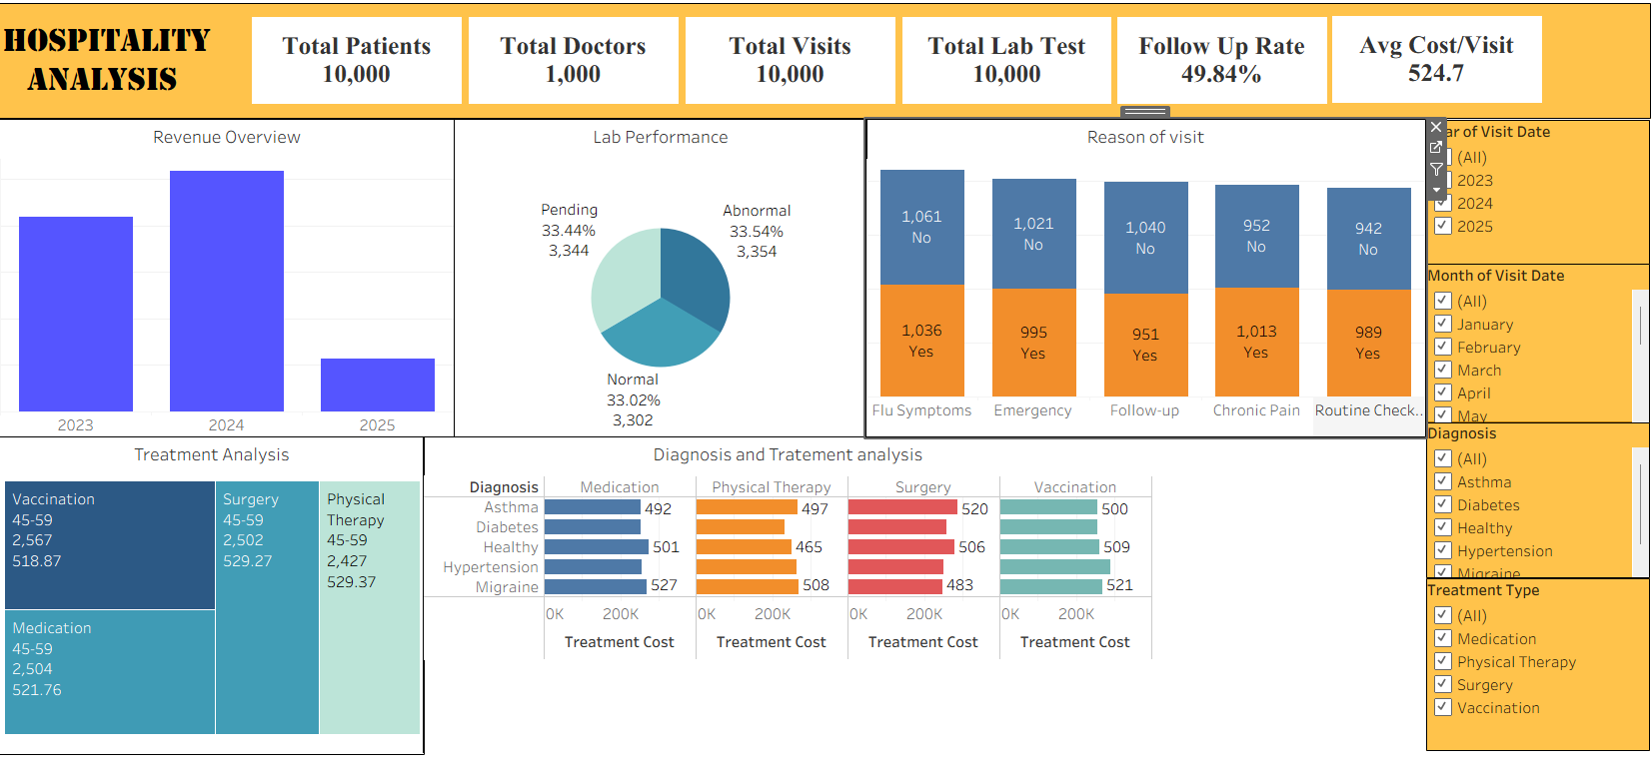
Lab performance
Lab Performance refers to the evaluation of laboratory test outcomes categorized as Normal, Abnormal, and Pending.
Quick identification of abnormal results enables doctors to start treatment without delay.
Tracking lab outcomes ensures patients receive timely follow-ups and proper medical attention.
High abnormal rates may indicate rising health issues, helping management take preventive actions.

Slide 8
Top 5 diagnosis and treatment cost
This analysis highlights the five most frequently diagnosed medical conditions and compares the treatment methods and associated costs for each condition
Helps identify the most common health conditions in the patient population.
Assists in estimating treatment expenses and revenue contribution.
Supports better budgeting and financial planning.
Enables efficient allocation of doctors, specialists, and medical equipment.
Helps management focus on high-demand healthcare services.

Slide 9
Treatment Analysis
It helps measure how treatments contribute to patient recovery and hospital revenue.
Helps identify expensive treatments and manage hospital expenses efficiently.
Shows which treatments generate higher revenue.
Supports planning of doctors, equipment, and medicines.
Helps analyze which treatments are most effective.
Assists management in expanding high-demand services.

Slide 10
Excel DASHBOARD

Slide 11
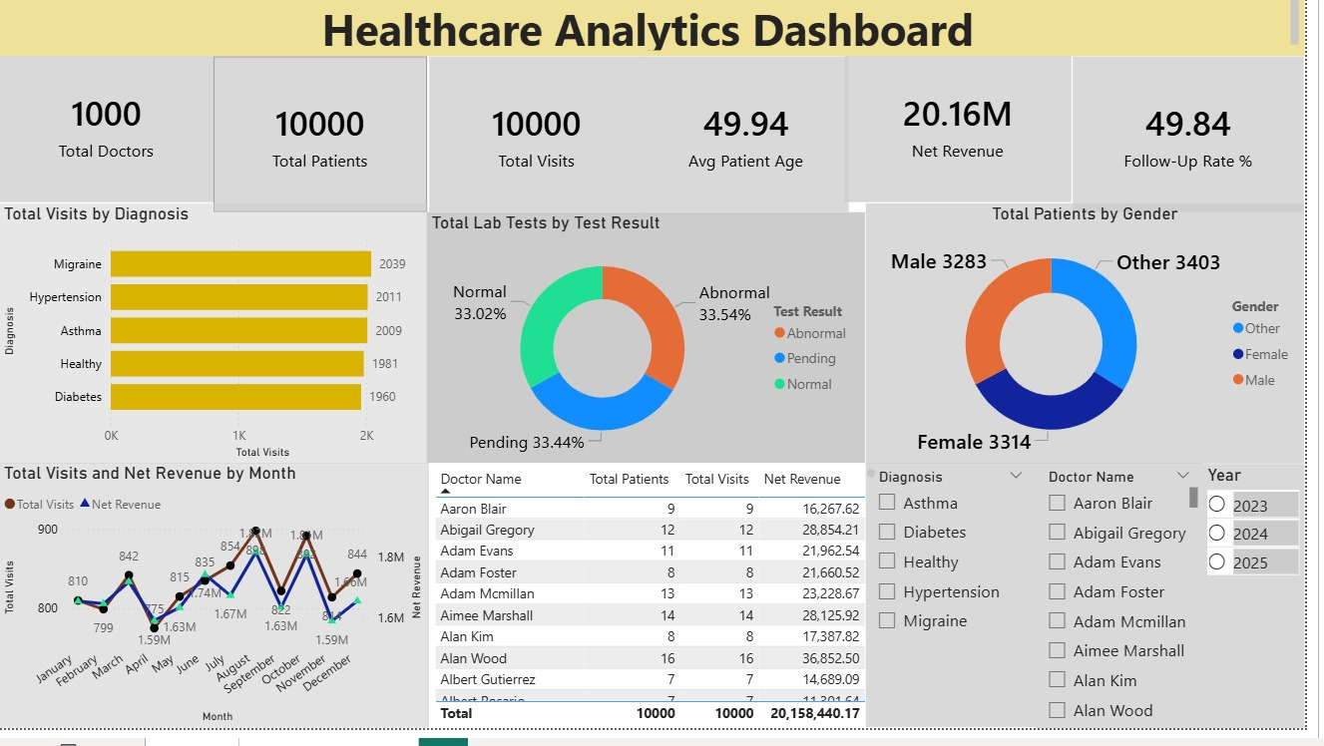
Power BI Dashboard

Slide 12
Tableau dashboard

Slide 13
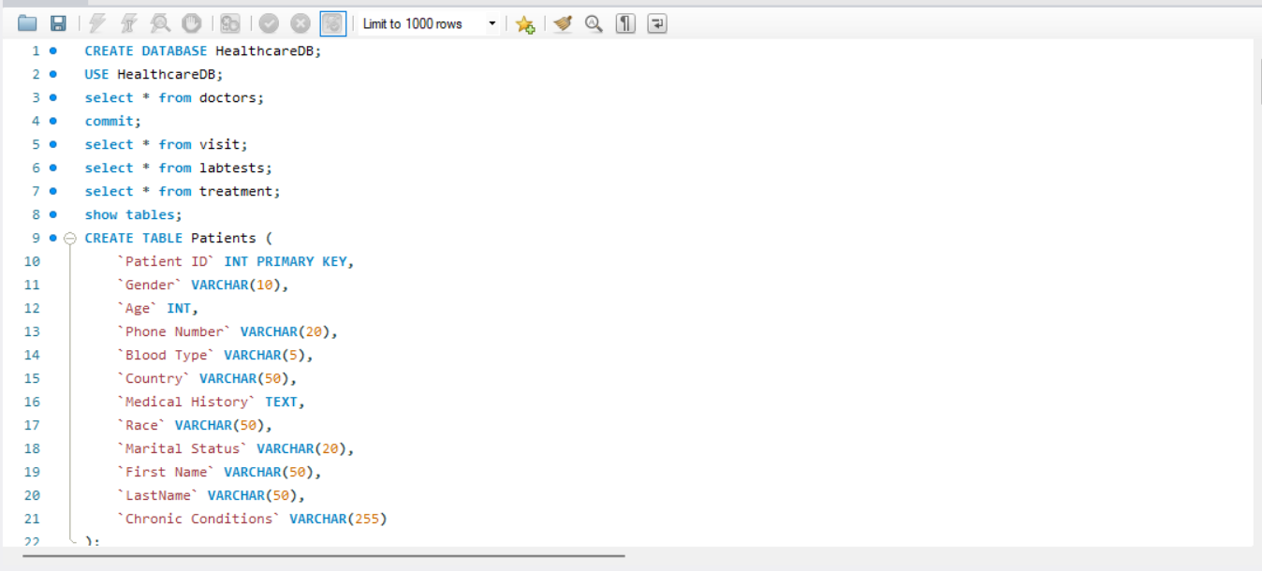
My sQl

Slide 14
CONCLUSION :
In conclusion, this project demonstrates how data analytics can improve hospital efficiency, optimize resource planning, and enhance patient care quality.
By using advanced tools like Power BI, Tableau, Excel, and MySQL, we converted healthcare data into actionable insights that support strategic decision-making.
This analytical approach helps hospital management identify performance gaps, reduce operational delays, improve diagnostic turnaround time, and allocate medical resources more effectively.
It also enables proactive decision-making by highlighting high-demand treatments and frequently diagnosed conditions.

Slide 15
THANK YOU

